Slide 2
Ecological results

Slide 3
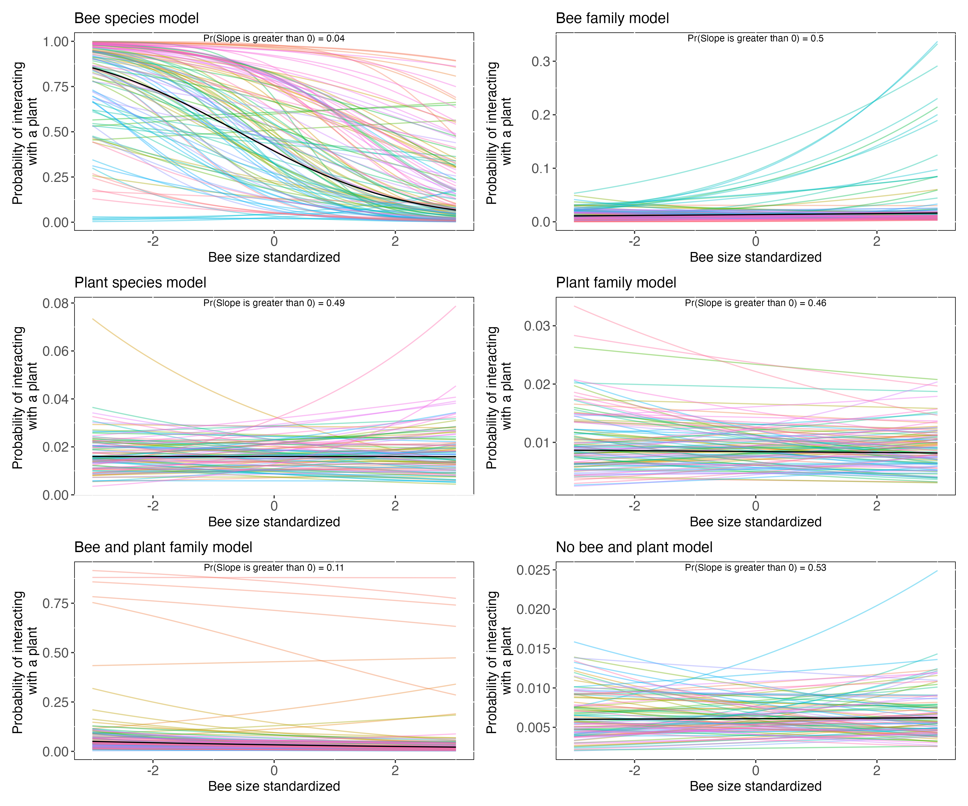
Take-away:
Mixed results for probability of interacting with a plant and bee size
Only significant relationship is for the bee species model (upper left) = negative relationship
Bee and plant family model showing some trend to significance
All others = no trend

Slide 4
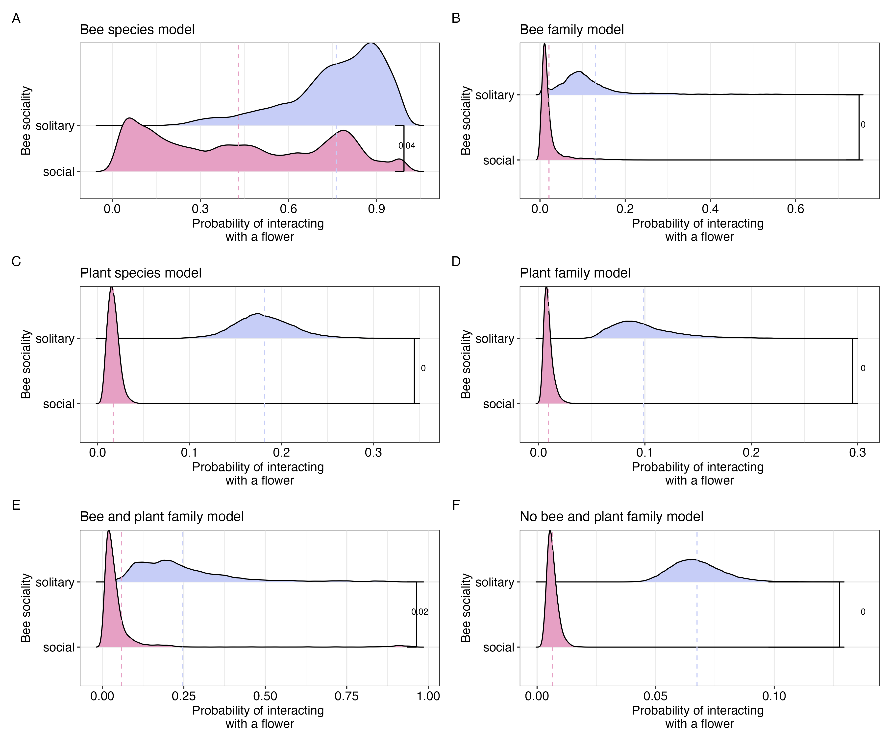
Take-away:
6 out of 6 models predict that solitary bees have a higher probability of interacting with a plant than social bees

Slide 5
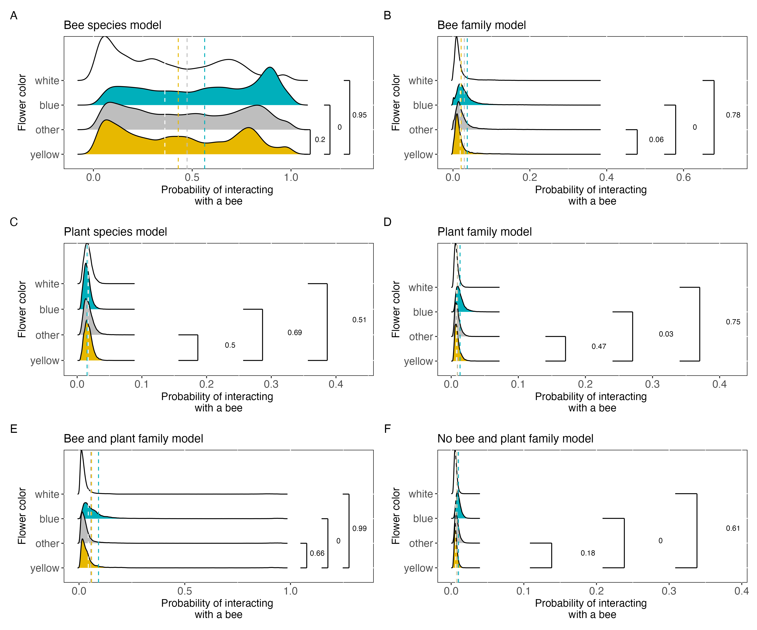
Take-away:
5 out of 6 models predict that blue flowers are visited more frequently than yellow flowers
2 out of 6 models predict that yellow flowers are visited more frequently than white flowers

Slide 6
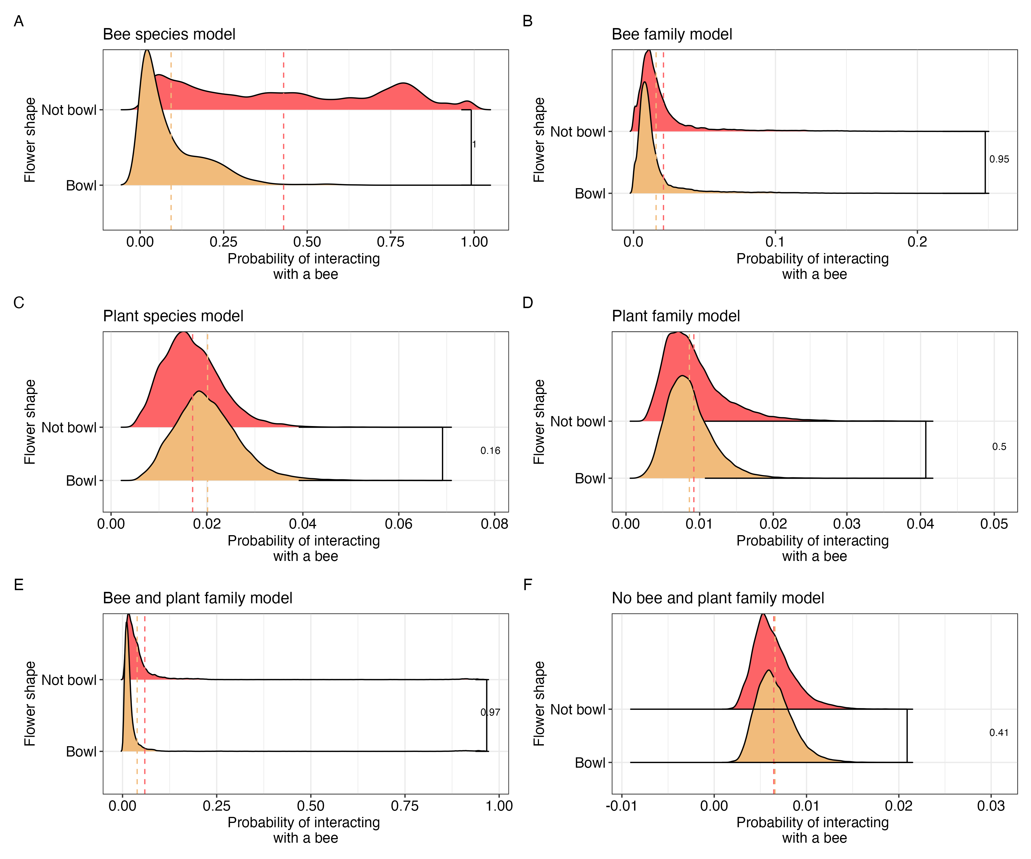
Take-away:
3 out of 6 models predict that not bowl flowers are visited more frequently than bowl flowers

Slide 7
Detection results

Slide 8
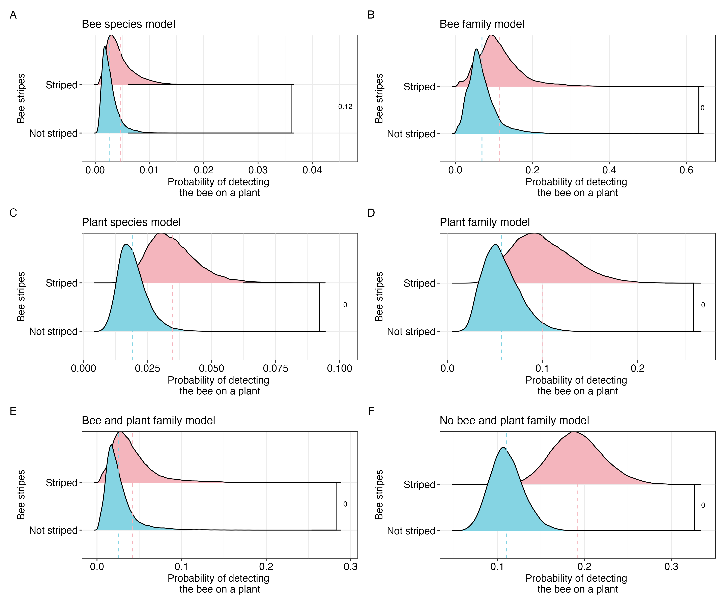
Take-away:
5 out of 6 models predict that striped bees are detected more frequently than not striped bees

Slide 9
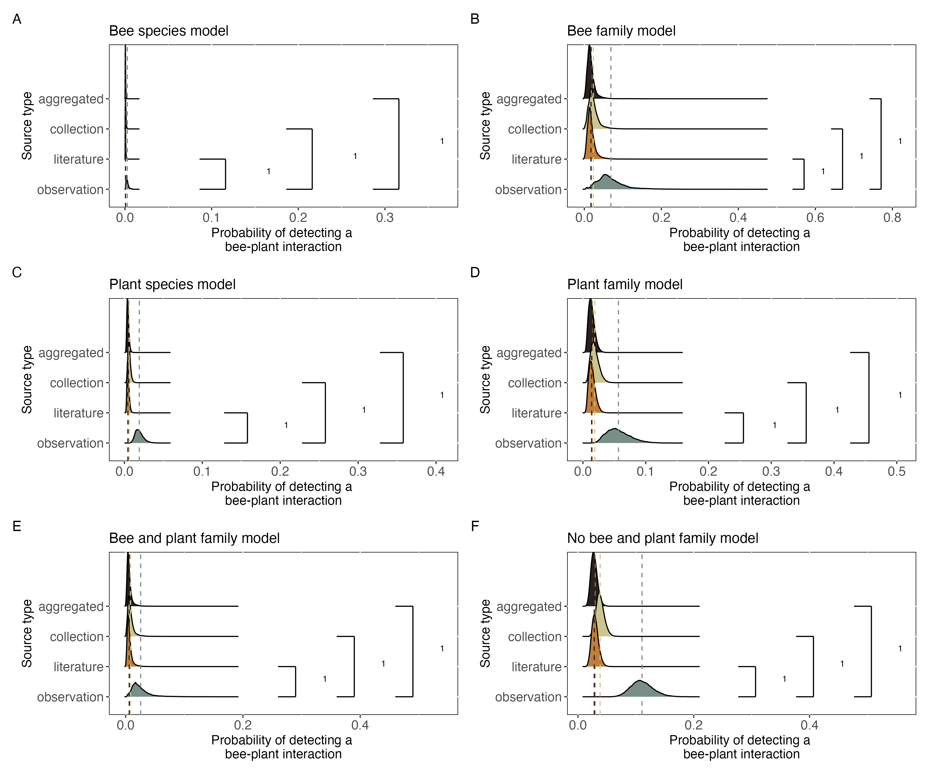
Take-away:
6 out of 6 models predict that observations detect more bee-plant interactions than any other source type

Slide 10
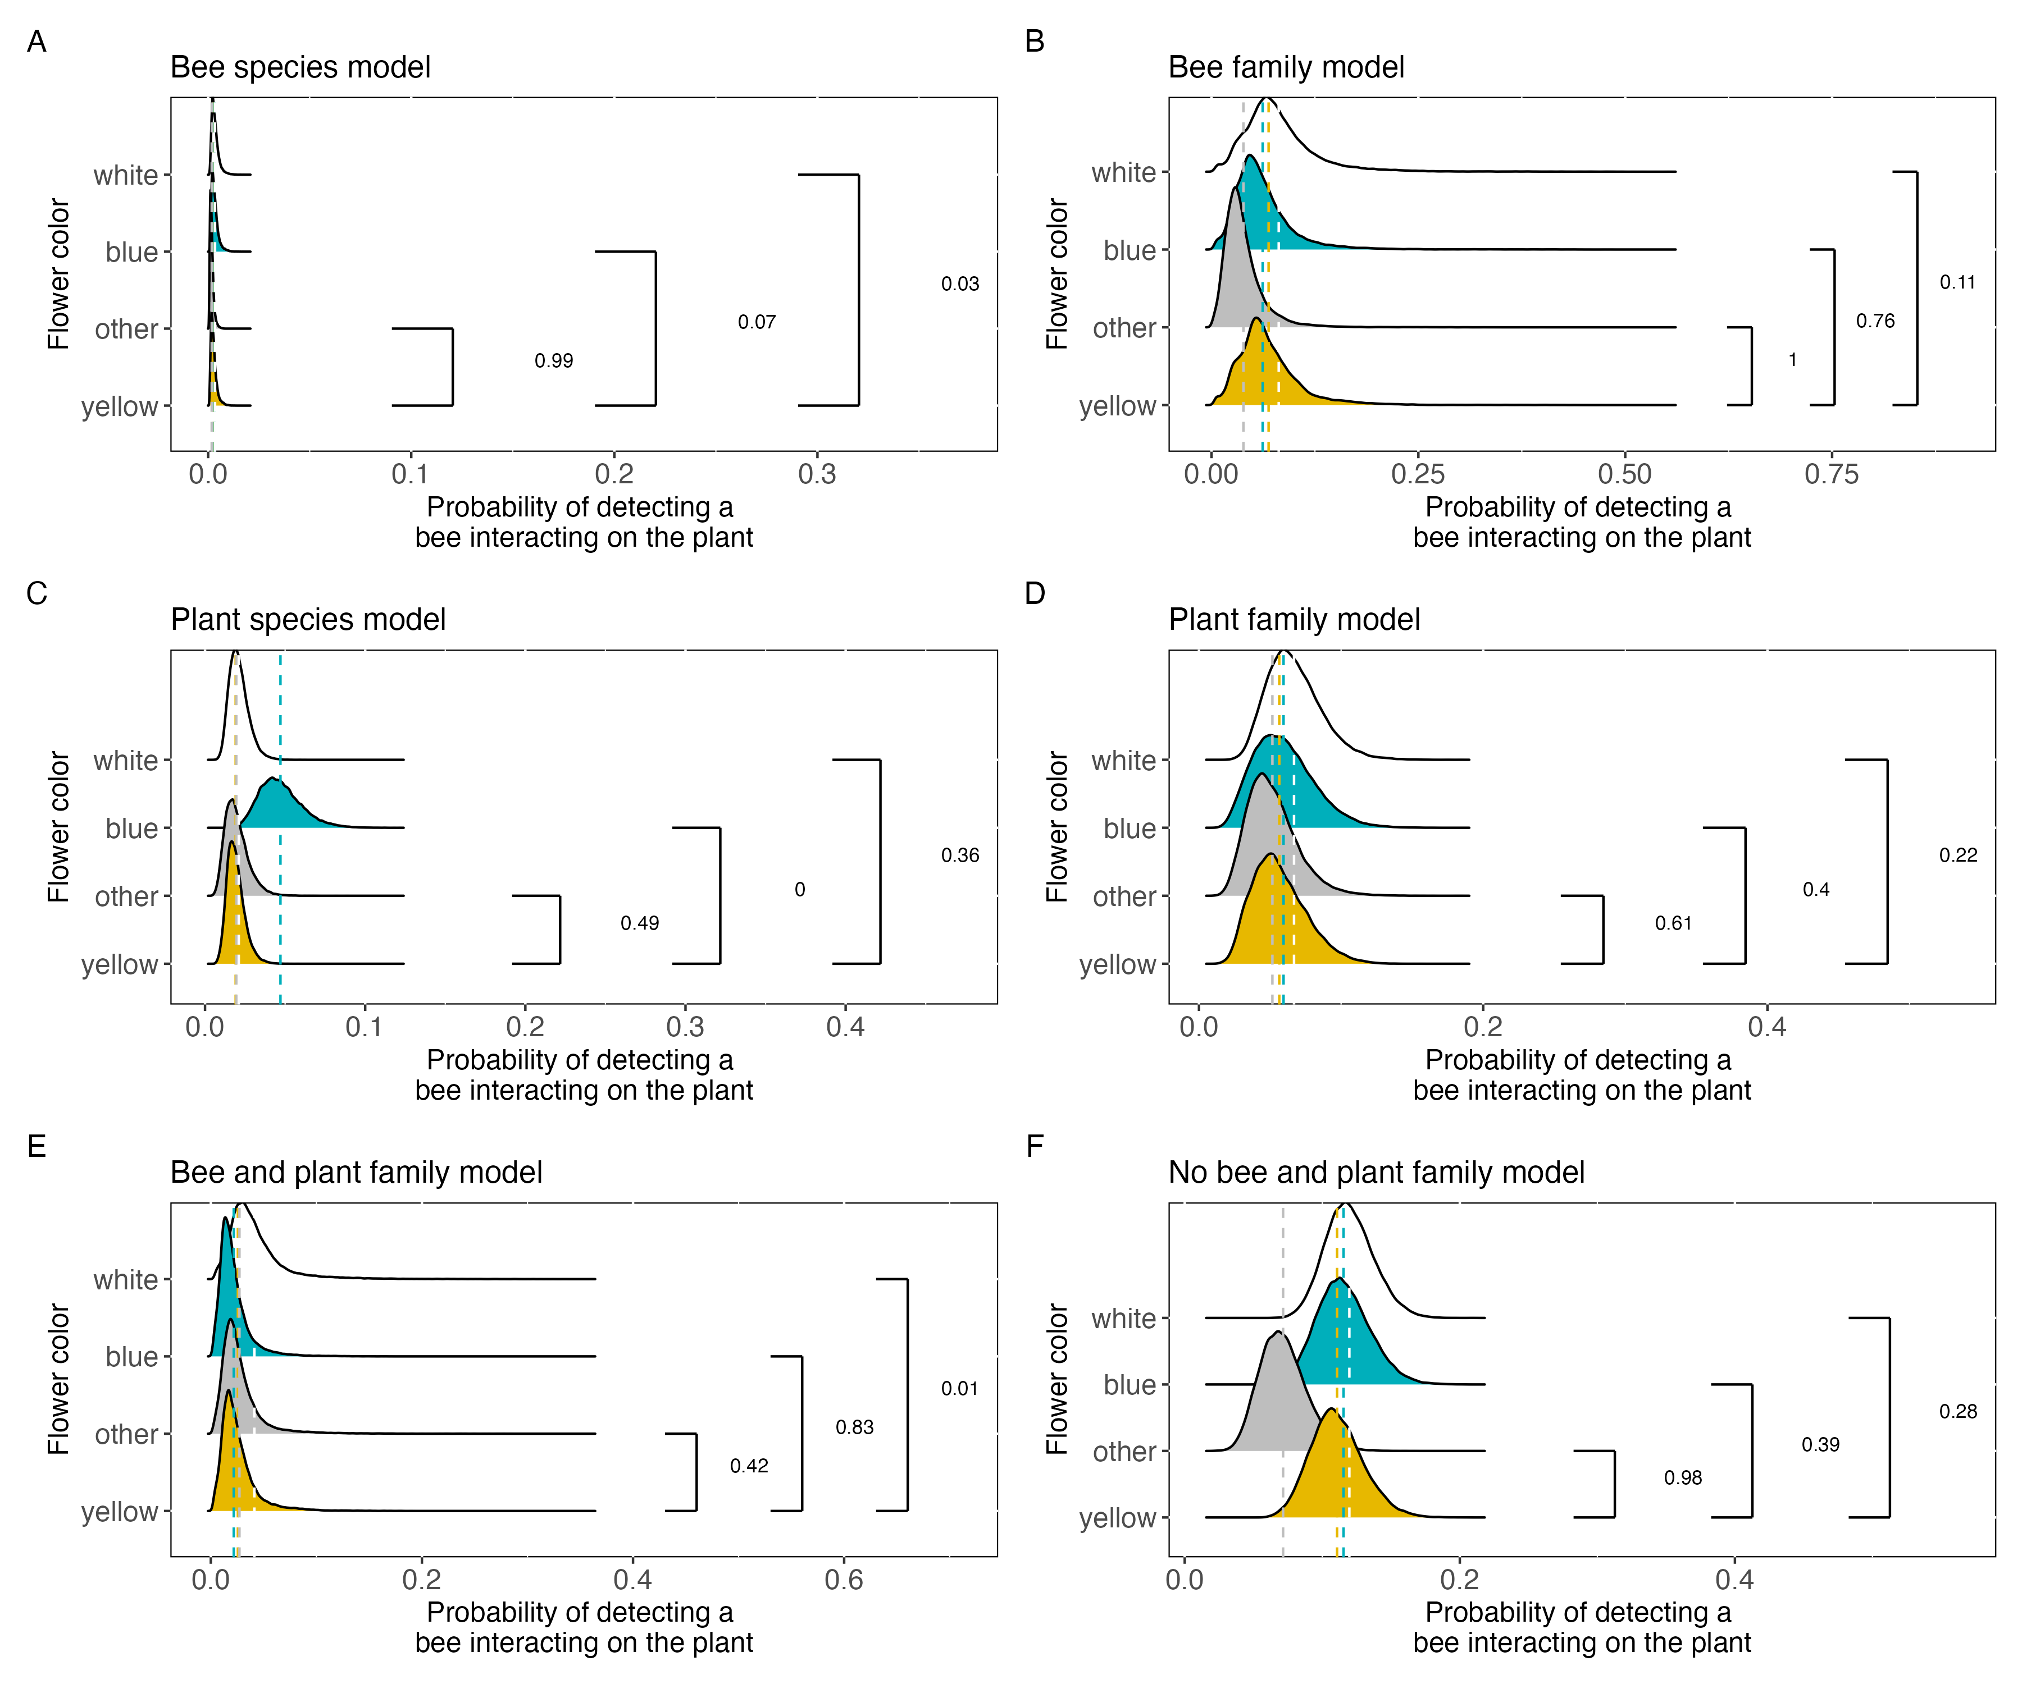
Take-away:
3 out of 6 models predict that yellow flowers have a higher probability of having a bee detected on them than ”other” colored flowers
2 out of 3 models predict that blue flowers have a higher prob of having a bee detected on them than yellow flowers
2 out of 3 models predict that white flowers have a higher prob of having a bee detected on them than yellow flowers

Slide 11
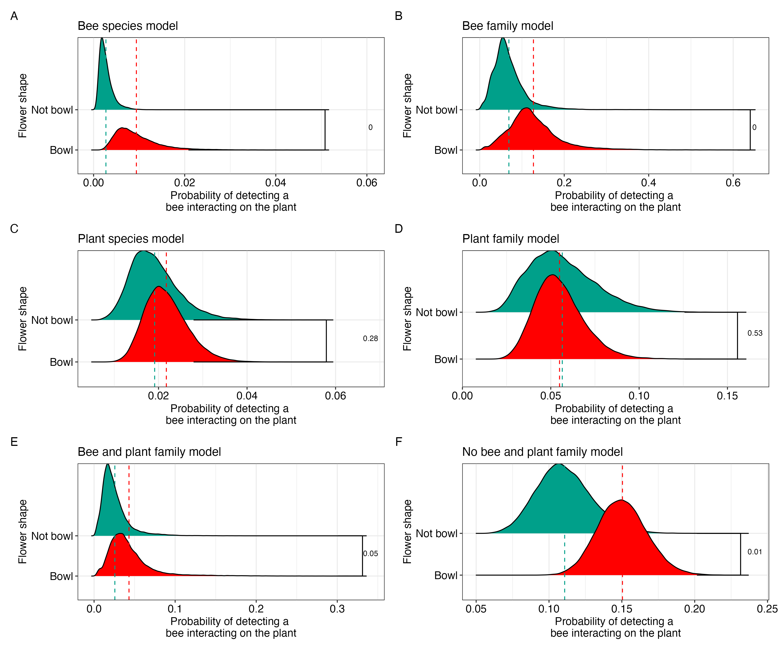
Take-away:
4 out of 6 models predict Bowl flowers have a higher probability of having a bee detected on them than Not bowl flowers

Slide 12
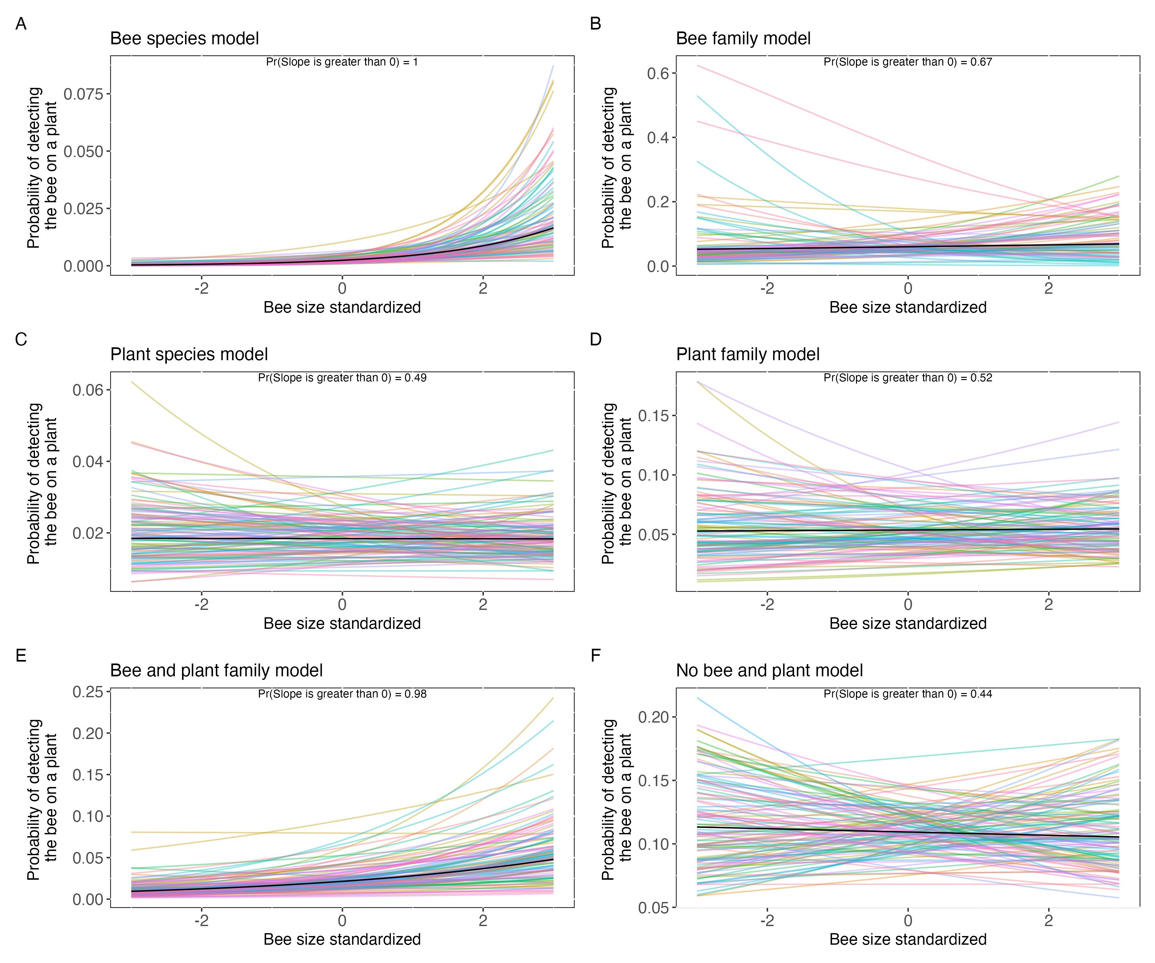
Take-away:
2 out of 6 models predict that bee size is positively correlated with the probability of detecting a bee on a plant

